Slide 1
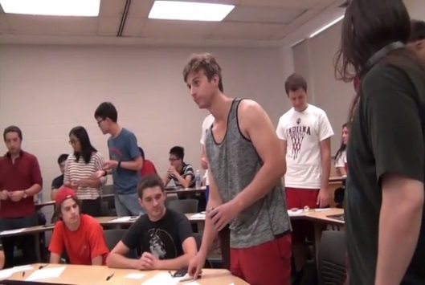
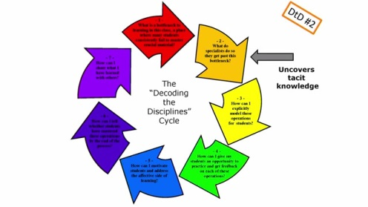
Inspiring examples
Decoding work of students
Bottleneck
https://www.youtube.com/watch?v=ySdGj6pG8gk
The Decoding the Disciplines Cycle
https://youtu.be/2uLKlWPpTCg
https://youtu.be/iNvQlm9phEI
https://youtu.be/iNvQlm9phEI
Decoding the Disciplines is a widely-used and proven methodology that prompts teachers to identify the bottlenecks – the places where students get stuck – that impede learners’ paths to expert thinking in a discipline. The process is based on recognizing the gap between novice learning and expert thinking, and uncovering tacit knowledge that may not be made manifest in teaching.
Computer
Algorithm
https://sty.presswarehouse.com/Books/BookDetail.aspx?productID=500505
https://youtu.be/zsTwYCbMmnQ
https://youtu.be/uglD6YMvUFE

